Slide 1
NCR Analysis
Raymond Martin Z. Castro

Slide 2
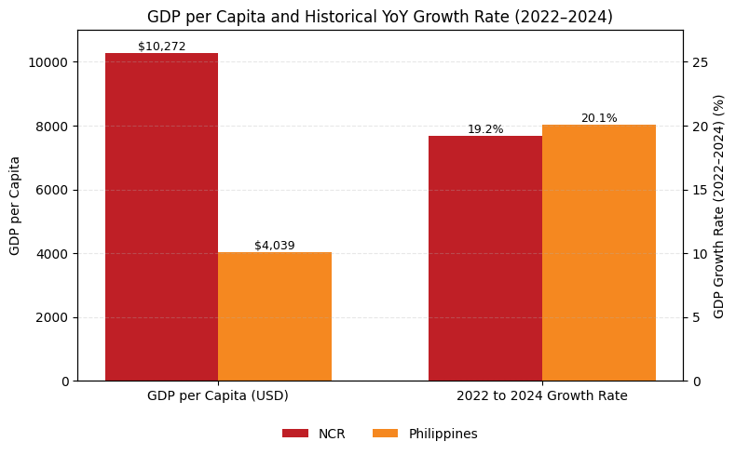
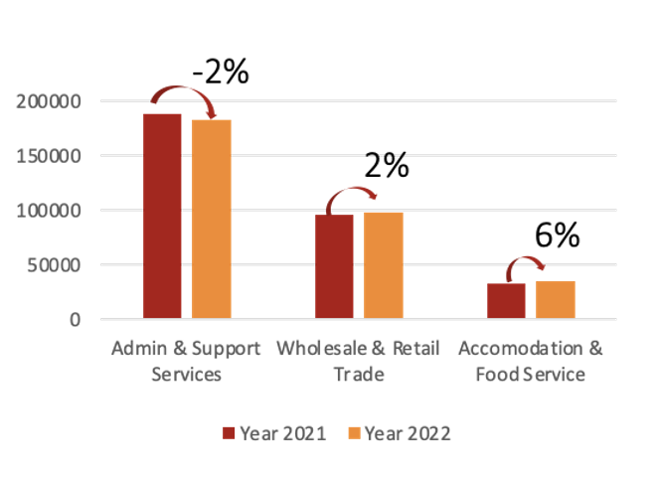
Region XX – one line summary about the potential of this region
Regional Economy and Labor Force Overview
Talent Supply and Demand Drivers
SUPPLY
DEMAND
Grads/yr: ###,###
Price driver
1
Admin & Support (##% LF)
New entrant in LF/yr: ##,####
2
Retail, F&B, Hospitality (##% of LF)
1
SHS, TVET
##,### SHS, with ###,### of annual graduates, with ##,### entering labor force
### TVET schools, with ##,### graduates
YoY Change in Demand per Top Sectors
2
HEI
GDP (2024, USD): US$146.7 bn
Regional Share of GDP vs National (31.1%)
## HEIs, producing ##,### of graduates every year
LABOR FORCE (LF)
Insights
For each region, depends on what the insight per region for the supply vs demand drivers
TESDA NCs which are supplying for the sectors are NC xxx, and NC xxxx
Other points you want to add
Unemployment Rate: #.#%
Median age: ##
Reference: FX applied USD: PHP: 1: 55
Sources: [link], [report]

Slide 3
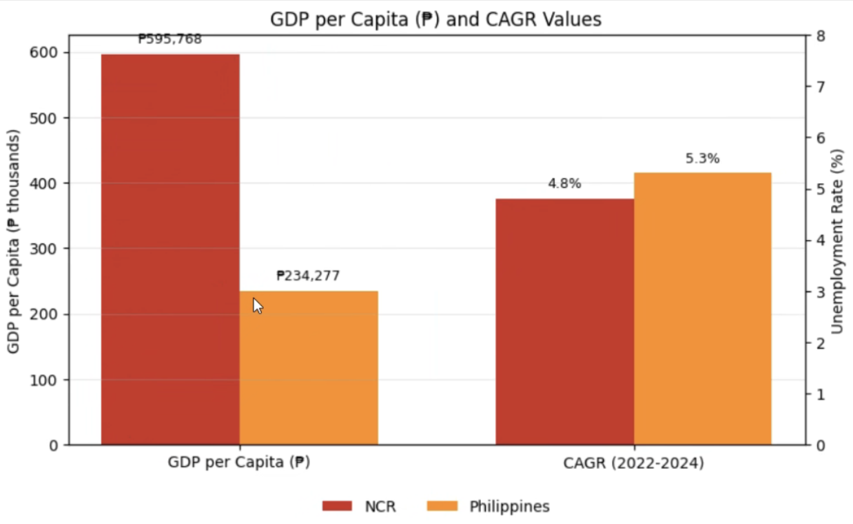
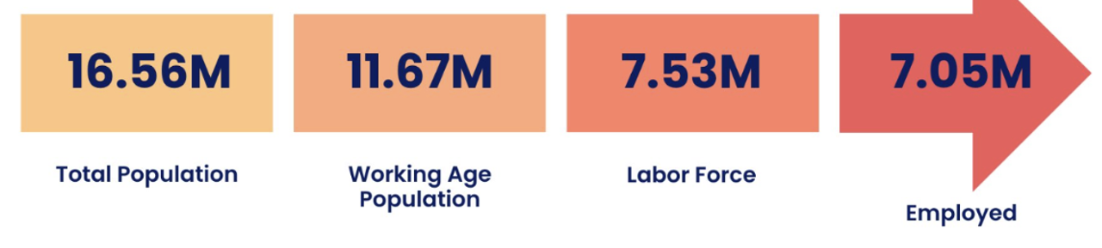
Region XX – one line summary about the potential of this region
Regional Economy and Labor Force Overview
Talent Supply and Demand Drivers
SUPPLY
DEMAND
Grads/yr: ###,###
Price driver
1
Admin & Support (##% LF)
New entrant in LF/yr: ##,####
2
Retail, F&B, Hospitality (##% of LF)
1
SHS, TVET
##,### SHS, with ###,### of annual graduates, with ##,### entering labor force
### TVET schools, with ##,### graduates
YoY Change in Demand per Top Sectors
2
HEI
GDP (2024, USD): US$##.## bn
Regional Share of GDP vs National (##%)
## HEIs, producing ##,### of graduates every year
LABOR FORCE (LF)
Insights
For each region, depends on what the insight per region for the supply vs demand drivers
TESDA NCs which are supplying for the sectors are NC xxx, and NC xxxx
Other points you want to add
Unemployment Rate: #.#%
Median age: ##
Reference: FX applied USD: PHP: 1: 55
Sources: [link], [report]

